Slide 1
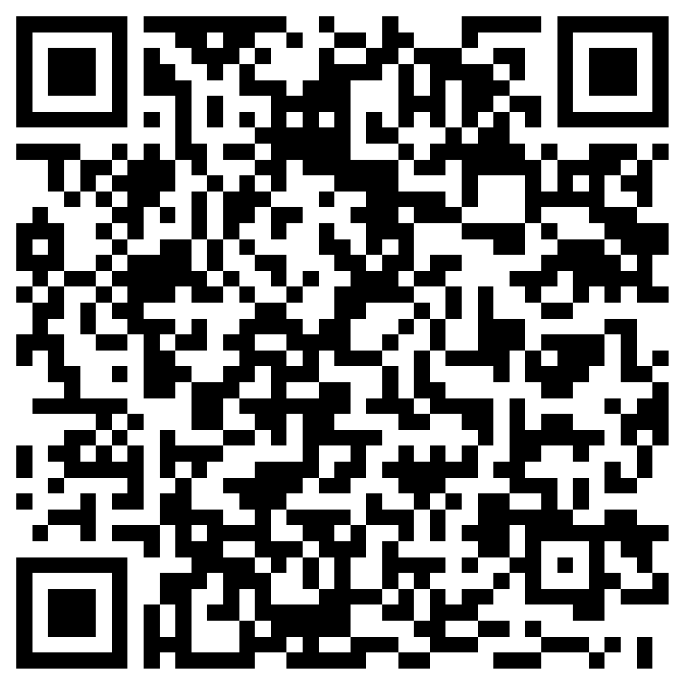
Join The Coding Club
To get on the email list and get more info, scan the QR code and fill out the form
Meetings will be held at 19:30 online on Wednesdays
https://sunymaritime.zoom.us/j/89642773260?pwd=NmhwUnM4UDVSM3lWWmdYeHhUWW1TZz09
All are welcome from the most experienced coders to absolute beginners

